Slide 1

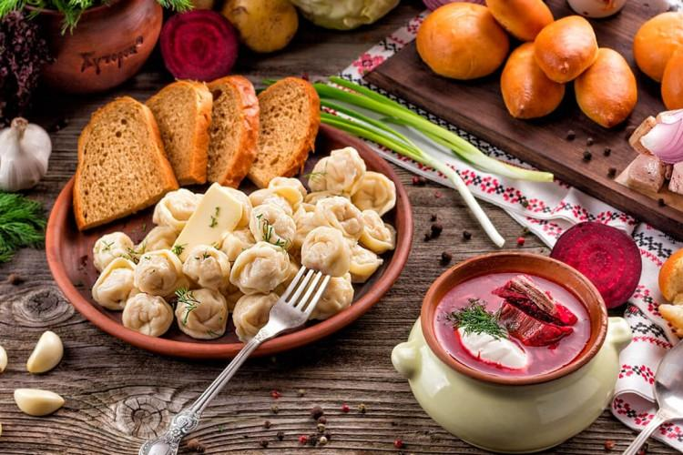
Traditional Dishes of Russian Cuisine

Slide 2
Russian people have always been known for their hospitality. They are happy to welcome guests with lavish dinners with abundance of food on the table.

Slide 3
Russia is a huge country and that is why Russian cuisine is a rich collection of diverse cooking traditions. Russian food has its own peculiarities due to the country’s severe climate in winter and its forests rich in berries, mushrooms in summer. Traditional Russian dishes are often made of vegetables, different crops, dairy products, fresh-water fish, poultry and meat.

Slide 4
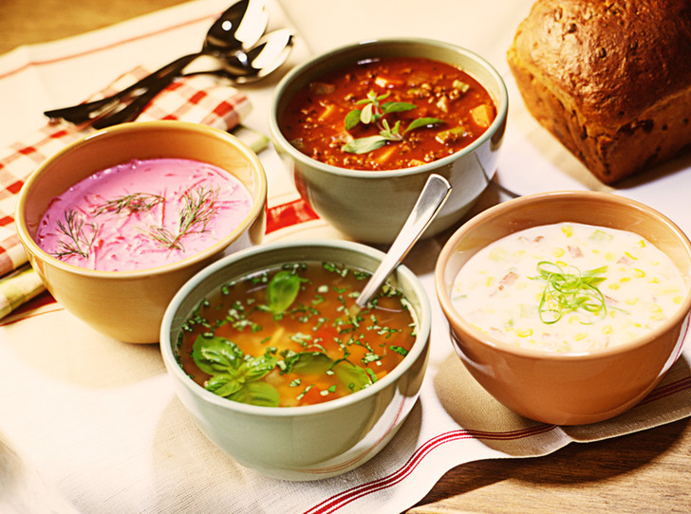
The most popular Russian soups
The most popular Russian soups, which are well-known all over the world, are borshch, shchi, and the cold summer soup okroshka. There are a lot of regional recipes for these dishes, but traditionally, both borshch and shchi are coocked from hard meat or bone broth and are served hot with sour-cream and rye bread.

Slide 5
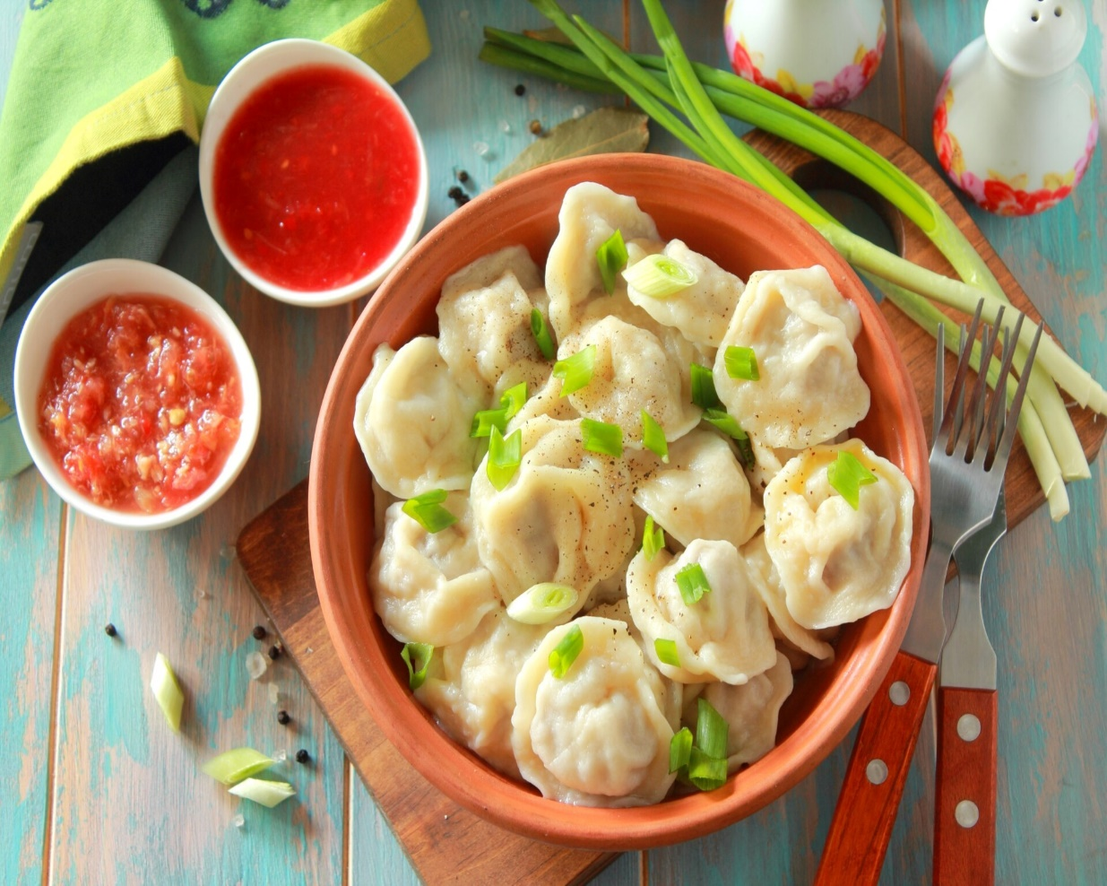
Pelmeni
Pelmeni is one more famous Russian dish. Small balls from minced meat are wrapped into dough made of flour and eggs and then boiled in salted water usually with bay leaves. Pelmeni can be served with sour-cream, table vinegar or horseradish. The filling can be made of any sort of meat – pork, beef, lamb or chicken. A vegetarian analogue of pelmeni is vareniki, which is more popular in Ukraine. Fillings for vareniki can be made of cottage cheese, mashed potatoes, mushrooms, berries and so on

Slide 6
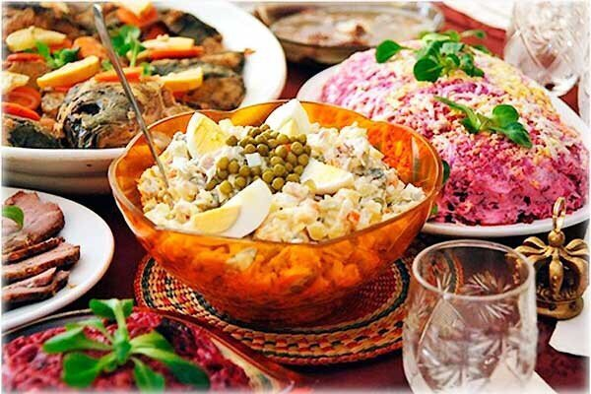
The most popular Russian national salads
The most popular Russian national salads are vinegret, Olivier salad (abroad it is sometimes called Russian salad), and “dressed herring”. Vinegret is a purely vegetarian salad, which is cooked from chopped boiled vegetables (beetroot, potatoes, carrots), fresh or sour cabbage, pickled cucumbers and onion.It is seasoned with vegetable oil. Olivier and herring salads are mayonnaise-based and rather substantial.

Slide 7
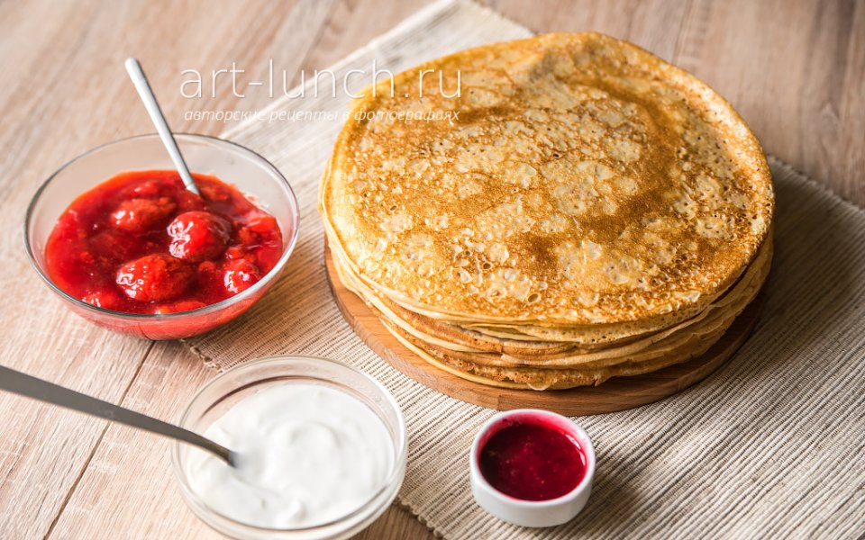
Blini
Of course, such a Russian national dish as blini should not be left unmentioned. Depending on the method of cooking and filling, blini can serve as a dessert or an appetizer. Blini are made of batter, which is poured on a hot frying pan and fried. Blini can be cooked of wheat, rye, oat, or buckwheat flour. They are served with run butter, sour cream, caviar, vinegar pickled mushrooms, berries or jam. Traditionally, blini have been cooked during the Maslenitsa festival, at the amd of winter, before the Great Fast.

Slide 8
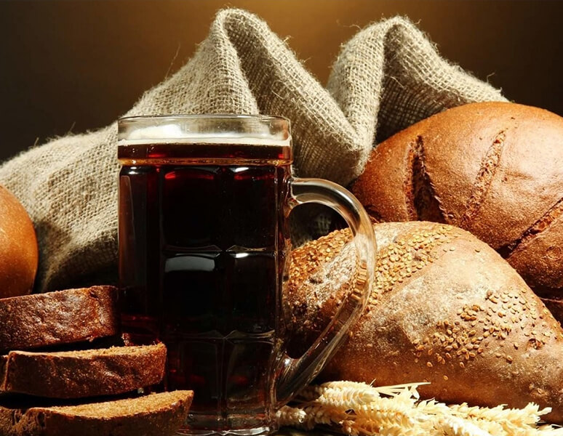
Kvass
A well-known Russian national beverage is kvass. Traditionally it used to be made of malt, rye bread and fresh water. Nowadays, in order to simplify the process of fermentation, they often add yeast into it. Traditional Russian kvass is a soft cooling beverage. It has a sour taste, and it can be used as a base for cold soups.

