Slide 1
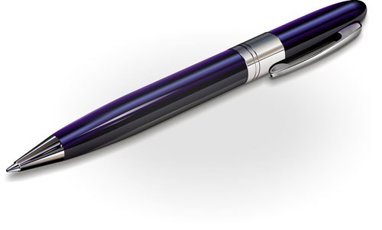
I see a pen.

Slide 2
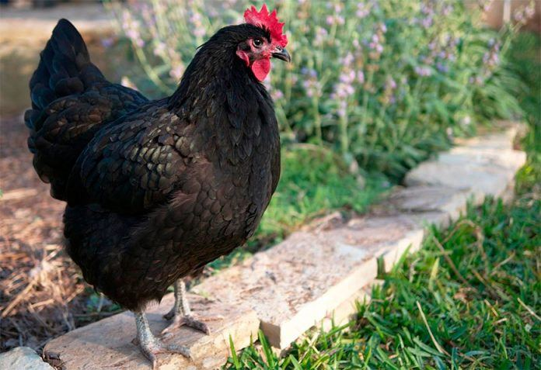
I see a hen.

Slide 3
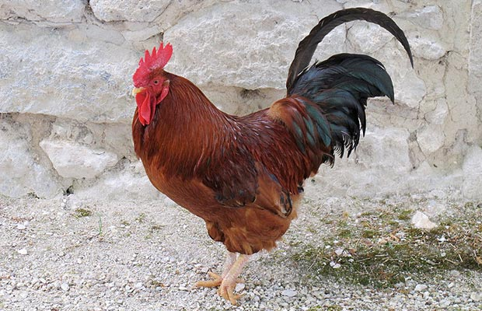
I see a cock.

Slide 4
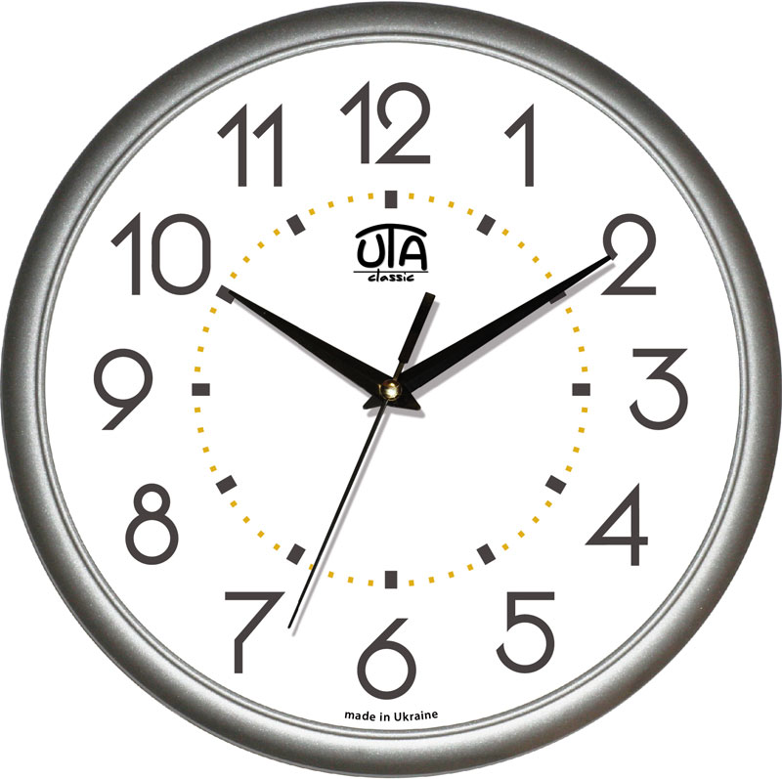
I see a clock.

Slide 5
I see a pen.
I see a hen.
I see a cock.
I see a clock.

Slide 6
I see a pen.
I see a
I see a cock.
I see a

Slide 7
I see a pen.
I see a _______.
I see a cock.
I see a _______.

Slide 8
I see a _____.
I see a _______.
I see a _______.
I see a _______.

Slide 9
I see a pen.
I see a hen.
I see a cock.
I see a clock.

