Slide 1
ship

Slide 2
sheep

Slide 3
fish

Slide 4
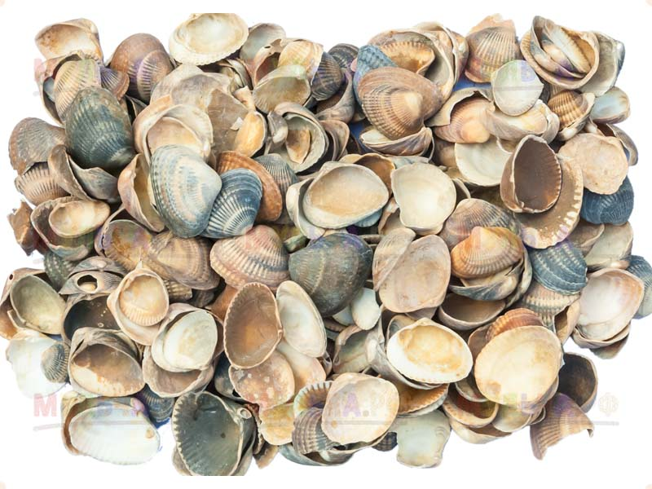
shell

Slide 6
cherry

Slide 7
cheese

Slide 8
chocolate

Slide 9
beach

Slide 10
phone

Slide 11
dolphin

Slide 12
whale

Slide 13
teeth

